Slide 1
Caribbean Oceanic and Terrestrial
Energy Equipment Limited
2014 Social Investment Project
“Small in Stature, but not Small in Heart, The Secret to our Success”
Presented by: Tricia Moonan
January, 2015
Notes:
Good Morning, as you can see I am not Tricia Moonan as shown in your programme. My name is Selvan Moonan. I’m one of the owners/directors of COTEEL.
We were quite surprised when we got an email from Arianne saying “Congratulations, you were shortlisted again”. We are delighted to be considered for this Award.
Today I'm going to share a story with you on “The Secret to COTEEL’s Success”.

Slide 2
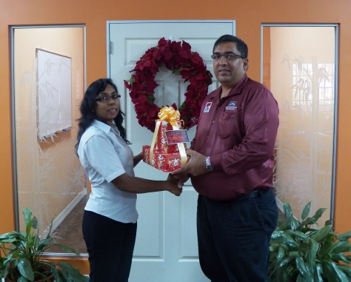
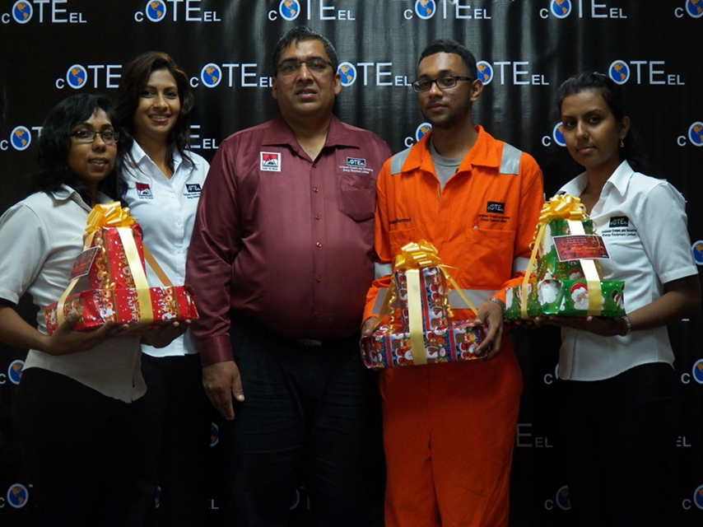
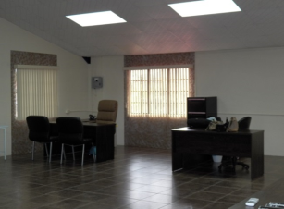
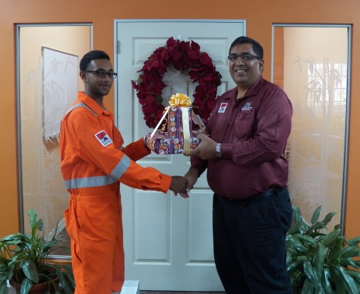
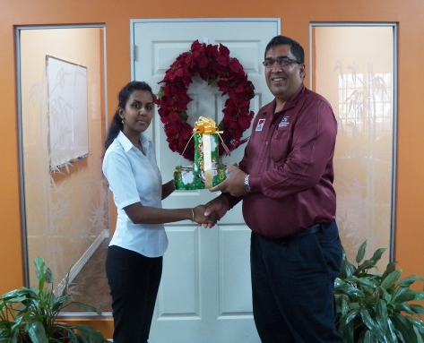
Hard Work,
Faith and Favour
Notes:
Once upon a time 2 people were in such dire straits that the day came when they just had $20 left between them. Later that same day, a good samaritan handed one of them $1500 in an envelope wanting nothing in return. Less than 1 year later those two people sold their first wrench and returned $2000.00 to the good samaritan as a blessing and thank you to him. The orders came pouring in afterwards in excess of $1M in the 1st year.
From that moment on and continuing today almost 4 years later the secret to our success is give first and grow after. This brings us to our theme” Small in Stature but not Small in Heart” . As a business we are 6 employees , 2 Directors and 4 Staff. We service engines, pumps, sell spare parts and water makers but at heart we are a people company.
The more you give, the more you will receive and grow - it is a law of the universe.

Slide 3
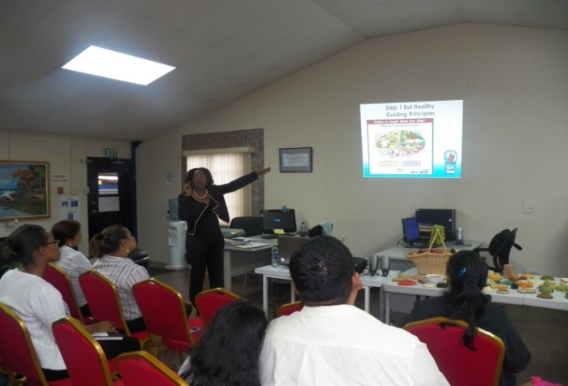
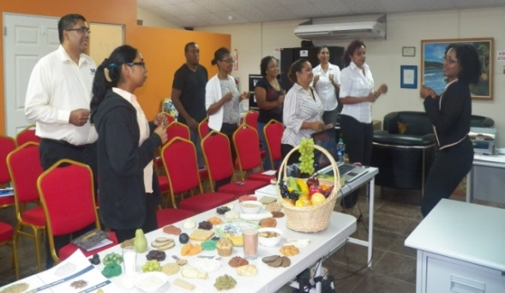
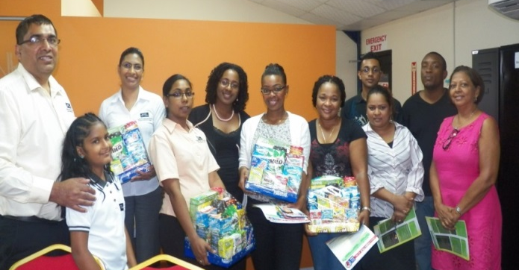
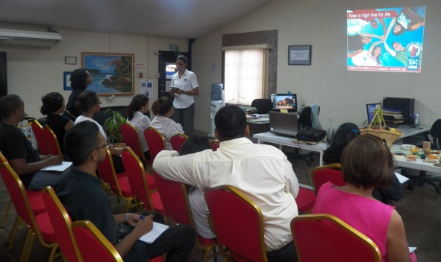
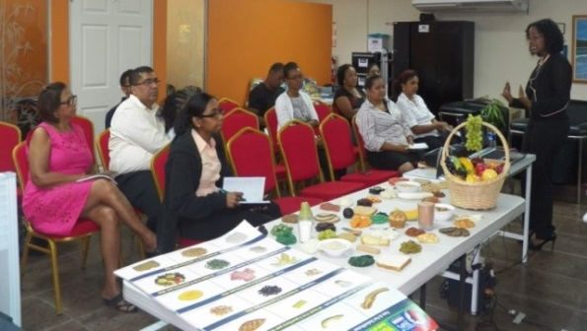
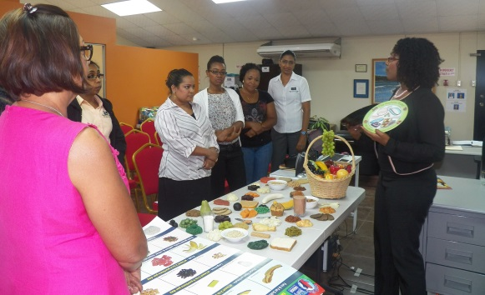
Living Well
Nestle Trinidad
Notes:
The story continues…..
We got together with people who shared a common goal and had the knowledge to help us reach out to our community.
Did you know the number one cause of Death in Trinidad and Tobago is Heart Disease and 23% of primary school children in Trinidad and Tobago are classified as overweight/obese (Ministry of Health, Health Report Card of Trinidad and Tobago, 2011).
Nestle Trinidad- Healthy Living and Balanced Diet
We made a difference in the lives of 12 families represented on the day ranging from ages 8 to 65 years.
Since this event we followed up with our employees and invited guests :
Daily toolbox meeting,
Implement 3 food groups rather than 2 when planning meals
Employee shared that she exercised for 20mins each day.
Longevity and looking after future generations are both a company and personal goal. When we develop people we build in a holistic way.

Slide 4
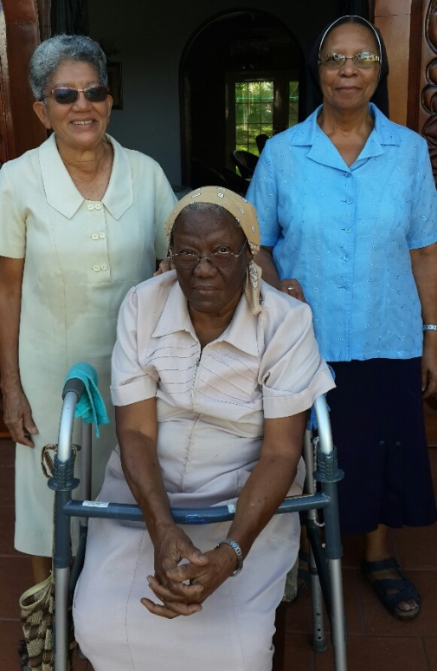
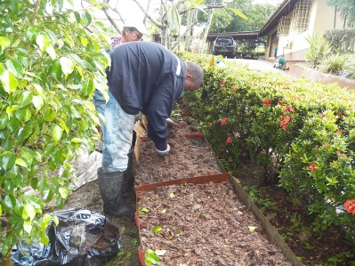
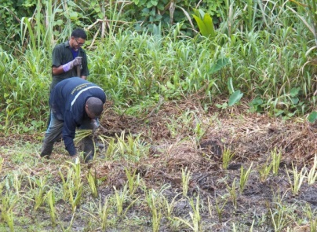
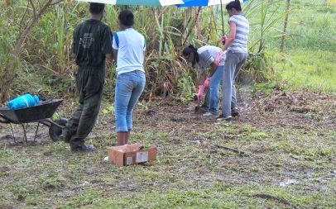
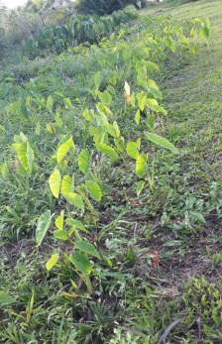
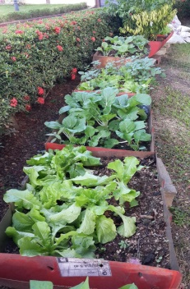
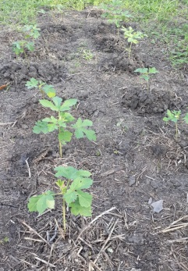
Planting with
St Joseph Convent Nuns
Notes:
Leading by example-
After teaching about balance diet we actually planted a food garden for the St Joseph Convent Nuns.
We made a difference in the lives of three retired nuns living on one pension,one NIS benefit and the goodwill of their fellowmen. All three have limited mobility – one has a broken hip and they jokingly say that its really one and half people living there not three.
Sister Annette, Odette, Genevive are grateful to us for closing the office for one day so that their food bill could be cut significantly over the next few months.
We can’t imagine in their remaining life how many more lives will be touched through COTEEL’s helping hand.
These women have given their life helping and supporting others. It is our turn to give back to them.
There are something in life money can’t buy for everything else there is master card.

Slide 5
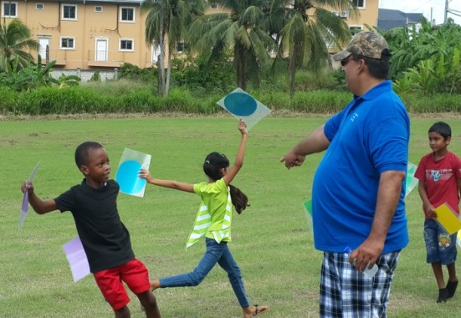
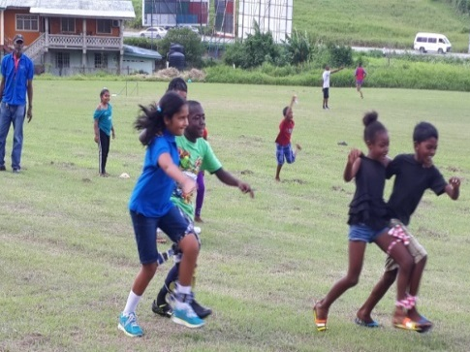
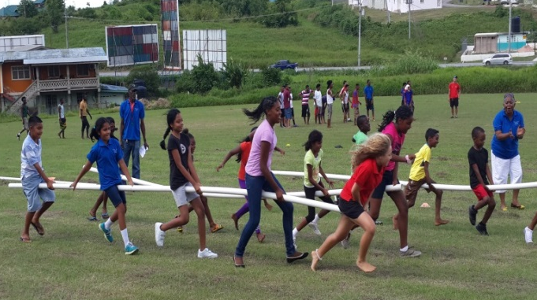
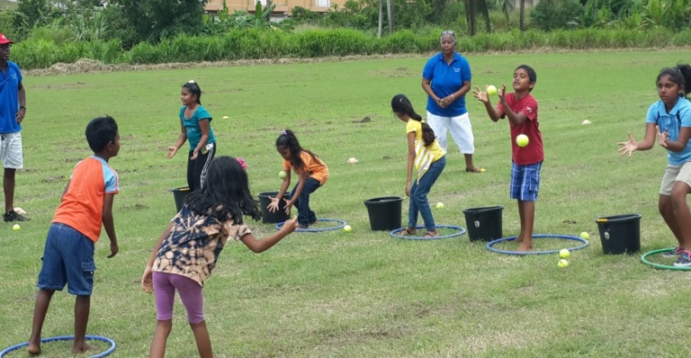
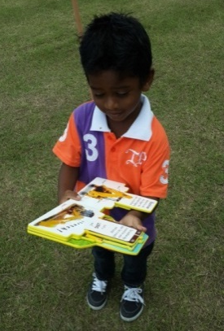
Retrench Sports
and Family Day
Notes:
COTEEL’s birthplace…. Retrench Village Sports and Family Day- a joint effort between COTEEL , St Joseph’s Convent and the residents of retrench village.
Retrench Village Sports Day, was the ideal opportunity for COTEEL to give back to its own home town.
Approx. 130 adults and their children were present.
The event went hand in hand with our Living Well initiative held earlier in the year.- promoting a healthy lifestyle.
We met Krishna who is the spokesperson for the young adults and we met Ram who is a mentally and visually disable woman who still work to own her keep. We lived there for 16 years and had it not been for this event we would have not met these people. We made sure both these people and all the children had no lack on that day. COTEEL sponsored the sporting equipment, ground preparation, helped with planning and judging.
The event was 100% better attended than the previous year. According to the Sisters, they liked working with people like us, people who keep their word and are committed. She said when she asks us to do something she knows that it will get done.

Slide 6
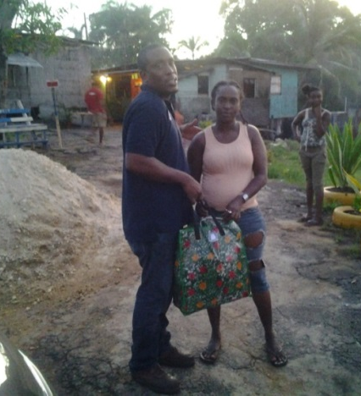
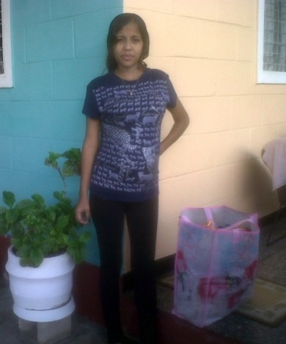
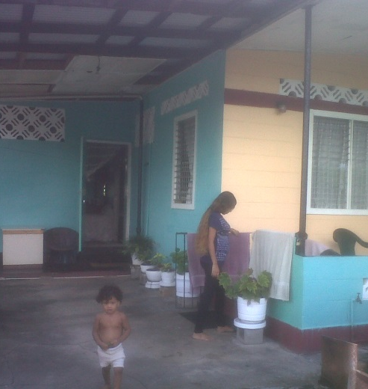
Distribution of
Food Hampers
Notes:
Because of the Family Day and closeness to the community we were able to…..
Identify persons who were in need of a quick helping hand. Ram was one of those people. Every employee found someone close to their home town to personally give a hamper to. 10 families benefited directly from COTEEL in this exercise.
But more than that because we were part of a bigger hamper drive through SHALOM Ministries 130 families got hampers.
COTEEL impacted 10 families within 7 communities. 6 employees making a difference in the lives of 30 people.
We will continue to give and sow seeds in the lives of others. Success is not how much you money you earn but the difference you can make.
“We believe that "small deeds done are better than great deeds planned”.

Slide 7
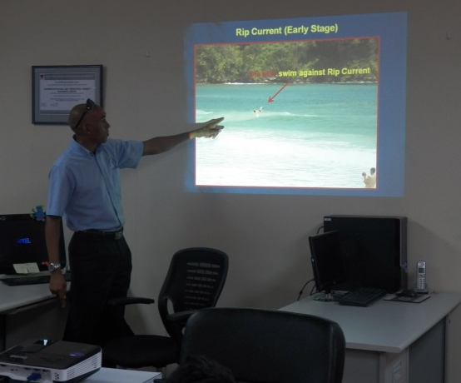
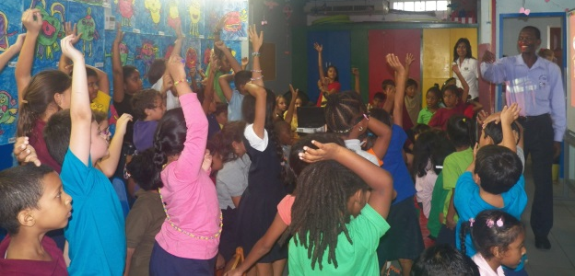
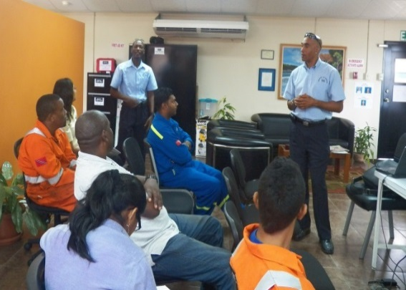
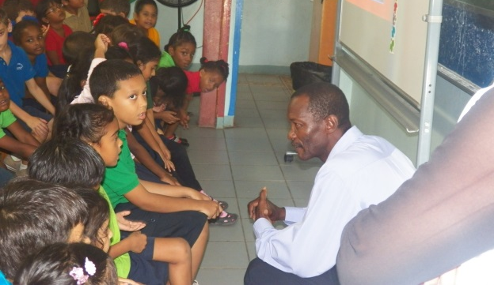
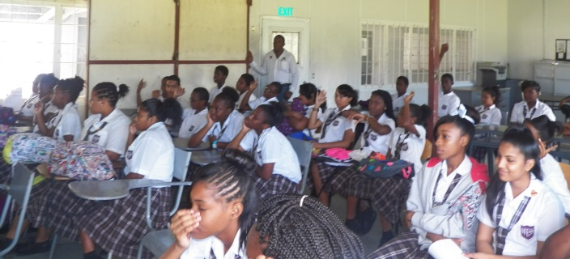
Beach Safety
Ministry of Tourism
Notes:
The first time we hosted a Beach Water Safety Session, was just in time for the Easter Weekend. This session was so successful we couldn’t keep it to ourselves.
We invited the Lifeguards from the Ministry of Tourism and extended our facilities to our clients and neighbours. Later on we hosted the same session in two schools in the community. We were able to reach children ranging from 4 years to 16 years and in total we got the word out to 150 people.
The Lifeguards shared that in the six (6) years of doing these education sessions, rescues have reduced by 40% in 2014.
We like to work in a holistic way and impact the people closest to us. It is hard for a small company to pick up and fund events because it is not only about financial resources but also time management. 4 out of 6 employees attended and assisted on the day of these events. There is a lot of multi-tasking in a small company, however at the end we choose to do it because we believe in working from our hearts and making a difference.

Slide 8
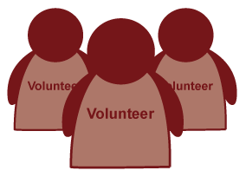
Monitor and Evaluate
136 hours
Expenditure
10%
Trainer Evaluation
Notes:
We spend knowing that our profit margin is smaller than of a bigger company so there is less to play with.
We need to understand that resources are not only about money but also about time, effort and ideas.
For a micro company of 6 staff members, impacting 400 plus people and by extension their families in 1 year, is a tremendous achievement.
We Spent more than 136 man hours volunteering to make all of this happen– this is equivalent to 1 person’s working hrs for 1 month.
10% of our expenditure for the year went into these projects ($65,000.00) – that could easily be the total stationery spending of another company.
Whenever we do a project we get feedback in formalised manner ( Trainer Evaluation Form)
It is a conscious choice we make to impact our community not for gratitude but for the hope of making a difference.

Slide 9
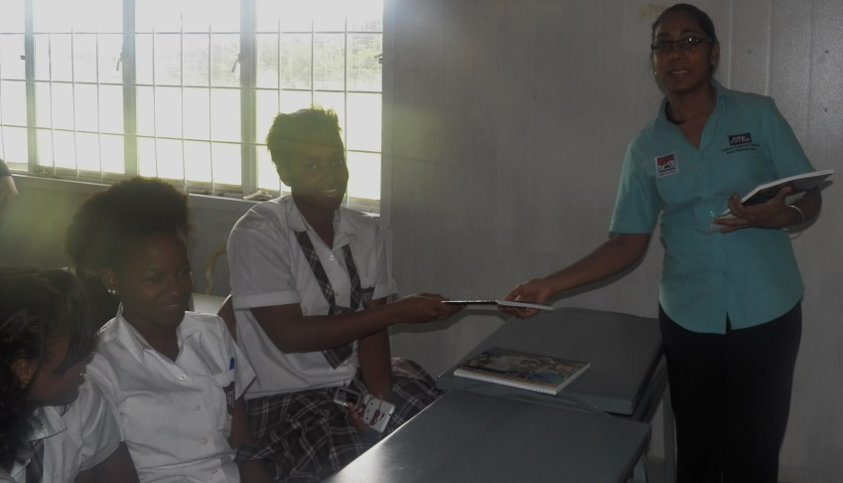
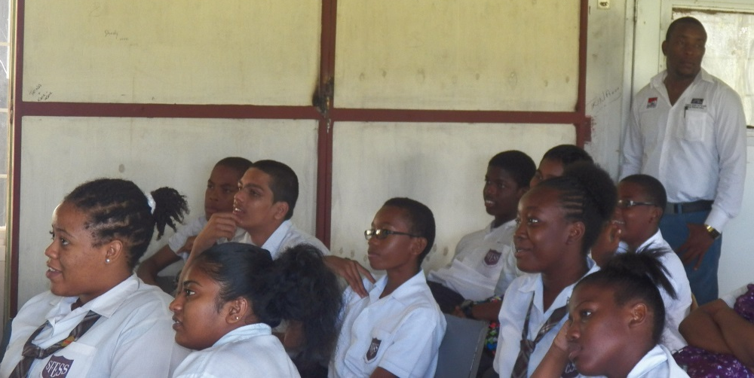
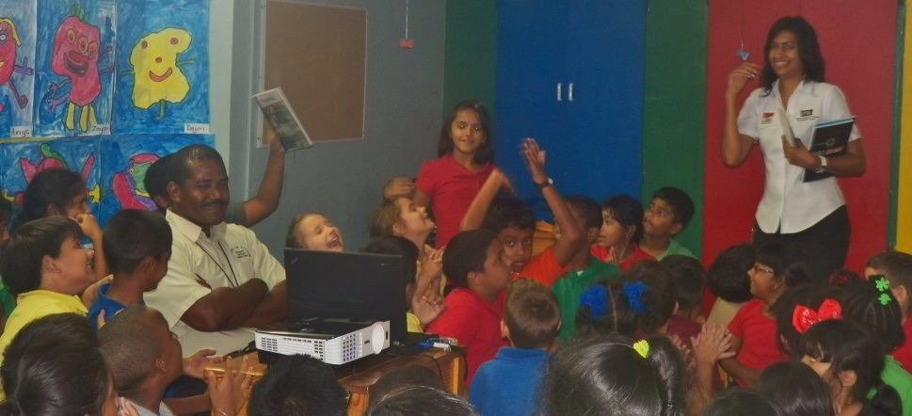
Innovation
Notes:
Most companies set a budget for CSR projects upfront. While we too manage our financial resources
We have decided..
That we will give first and grow after instead of grow first and then decide how much to give.
In the beginning we were small, then we invested in the lives of others and saw growth. Hard Work, Faith and Favour is the recipe for where we are today.
We support and assist others because we grow as individuals, as a team and as a company.
It helps us understand the real needs of people and group interaction between staff and communities.
Even though there is a finite amount of resources we will continue to send our limited staff to lend a helping hand just like a bigger company that can send 20 employees on a project. It distinguishes between a leader and a follower.

Slide 10
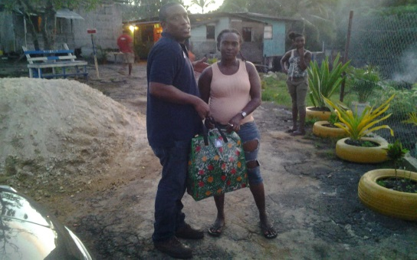
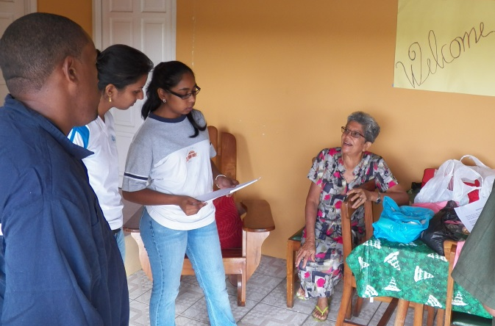
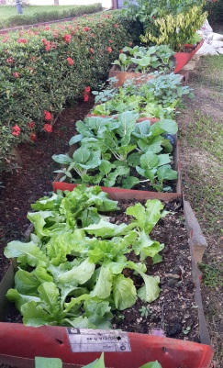
Sustainability
FOCUS
INVEST
LEAD
Notes:
Sometimes a need is the necessity to change the dynamic of community by creating brotherhood and togetherness.
We FOCUS on the lives of children because they are our future. Education is not something you can erase. Teaching a man to fish and feeding him for life as oppose to giving him the fish once only.
We LEAD by example.
We INVEST in the people lives around us.
For as long as we could do this we will do it. It is not about the money ,it’s about touching the lives of people. We grow as individual, as a team and as a company every time we do it.
According to Winston Churchill, “We make a living by what we get. We make a life by what we give.”

