Slide 1
An HSE Initiative of
COTEEL
in collaboration with
Ministry of Tourism: Life Guard Services
Presents
WATER SAFETY
May 23rd 2014

Slide 2
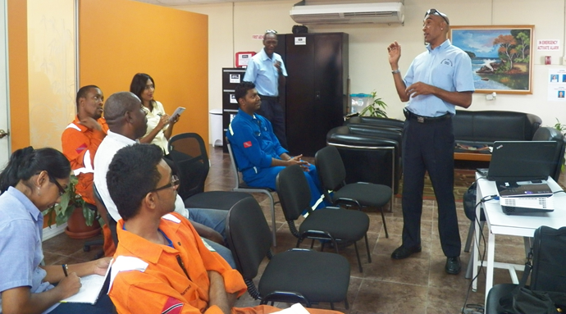
Friday 23rd May 2014 Ministry of Tourism: Life Guard Services, Water Safety Education Officers, Mr. Allister Livingston and Mr. Augustus Sylvester with COTEEL Staff and Invited Guests on a Water Safety Session

Slide 3
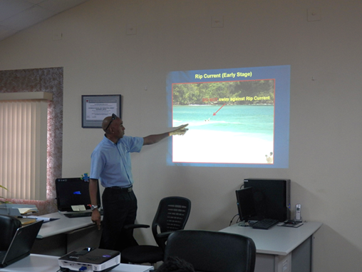
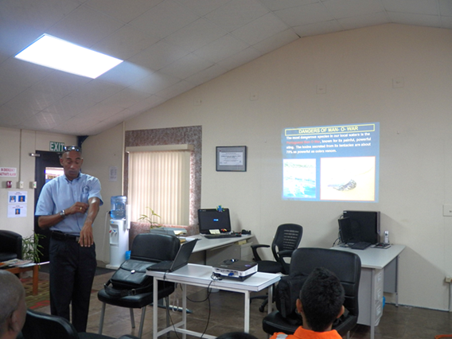
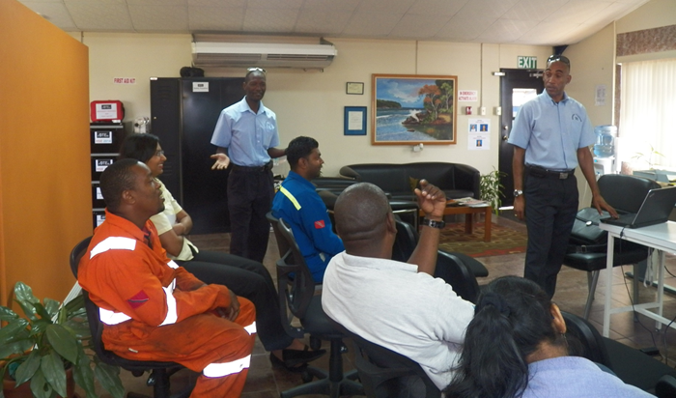
Photos: Ministry of Tourism- Water Safety
Mr. Livingston demonstrates how to recognise Rip Currents at Sea
Mr. Livingston outlines the most Dangerous Sea Species in local waters
“Portuguese Man O War”
Mr. Livingston and Mr. Sylvester in an interactive session with COTEEL staff and guests.

Slide 4
MINISTRY OF TOURISM
LIFEGUARD SERVICES
WATER SAFETY
Friday 23rd May 2014

Slide 5
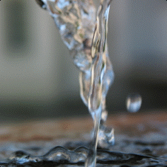
WATER SAFETY AT THE HOME

Slide 6
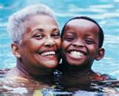
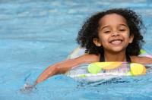
Water Safety at Home
Dangers of unsupervised children around water:
The home provides a number of unseen
Dangers, therefore;
Adult must always stay with children at bath time,
Always stay with children near water.

Slide 7
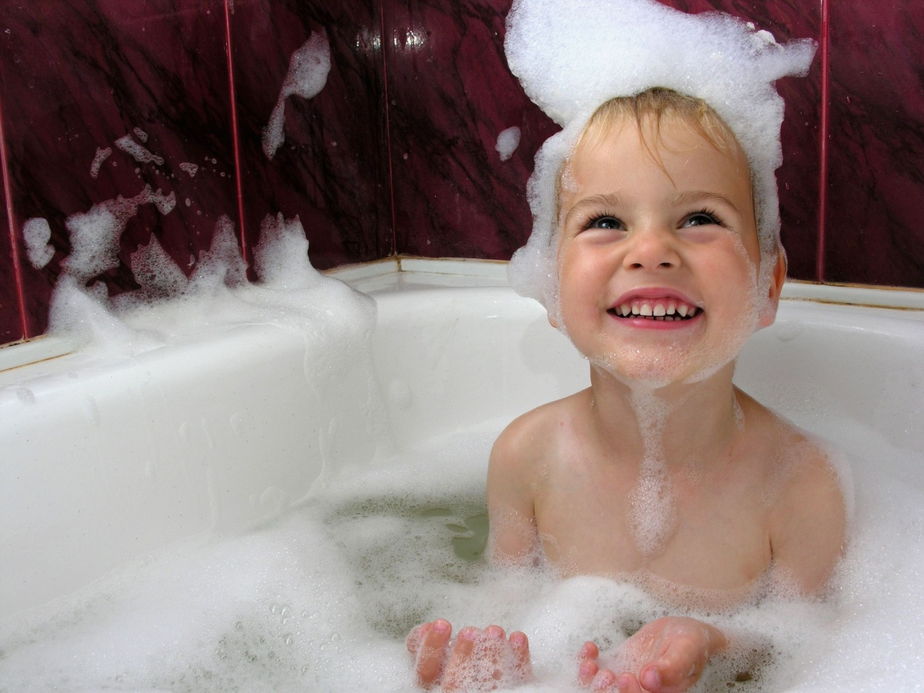
Water Safety at Home
Remember: Bathtubs could be slippery, a
person could fall and hit their head.

Slide 8
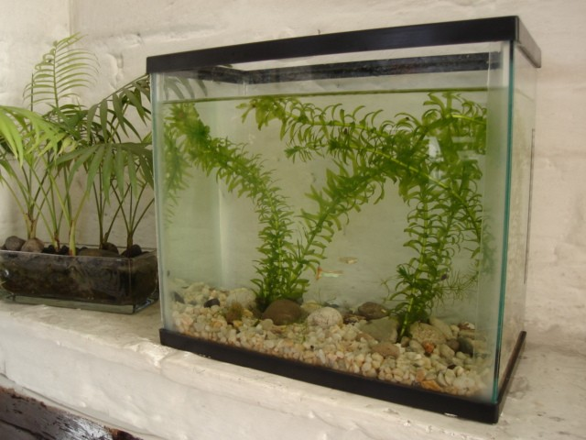
Water Safety at Home
Fish tanks should be covered properly with a wire mesh

Slide 9
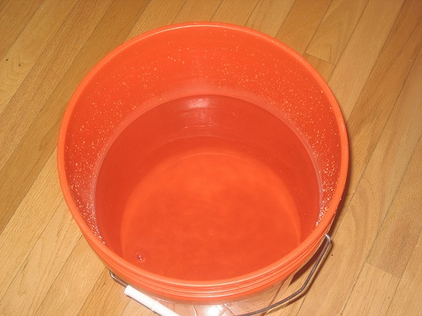
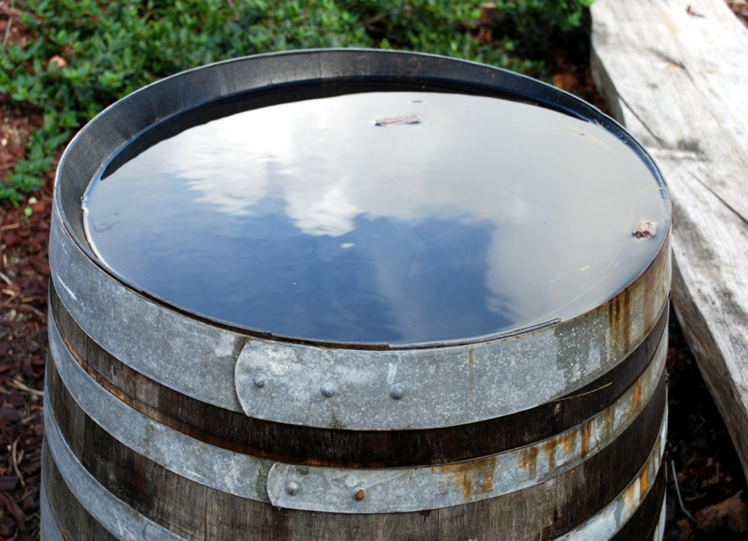
Water Safety at Home
Buckets, barrels, water tanks with stored water,
should be securely covered

Slide 10
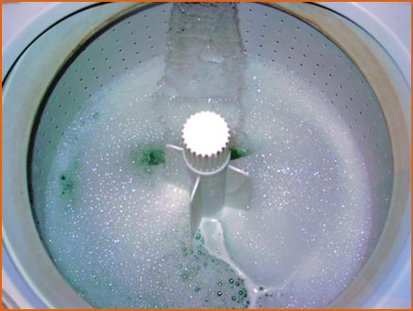
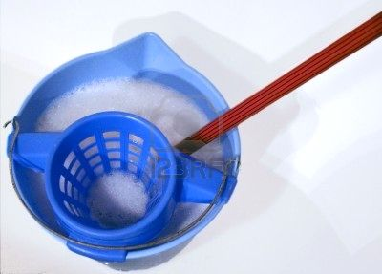
Water Safety at Home
Washing machines filled with water and not properly covered
½ buckets of water used for mopping should not be left unattended

Slide 11
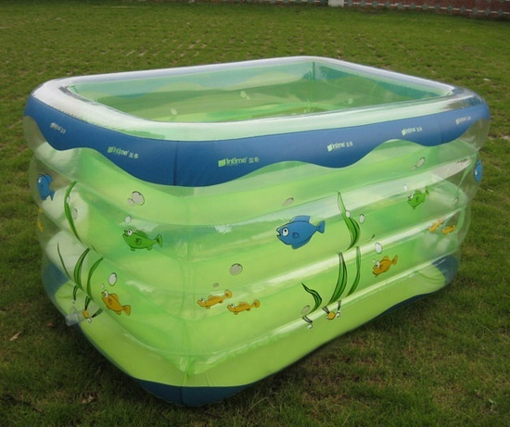
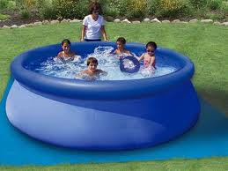
Water Safety at Home
Always empty and remove inflated pools immediately after use to avoid drowning

Slide 12
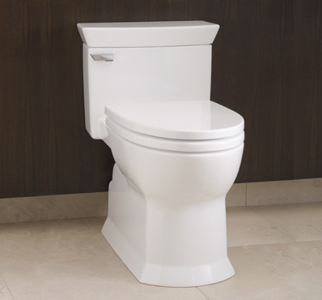
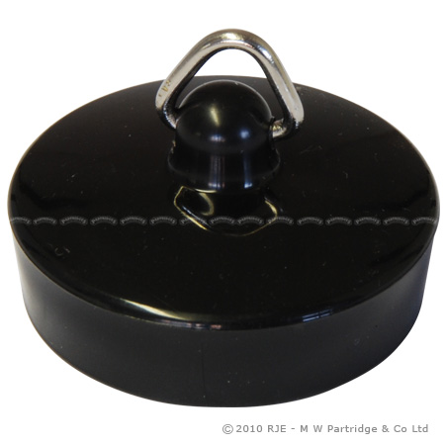
Water Safety at Home
Toilets bowls should be covered and bathroom
doors kept locked
Bathroom plugs should be kept out of children’s reach

Slide 13
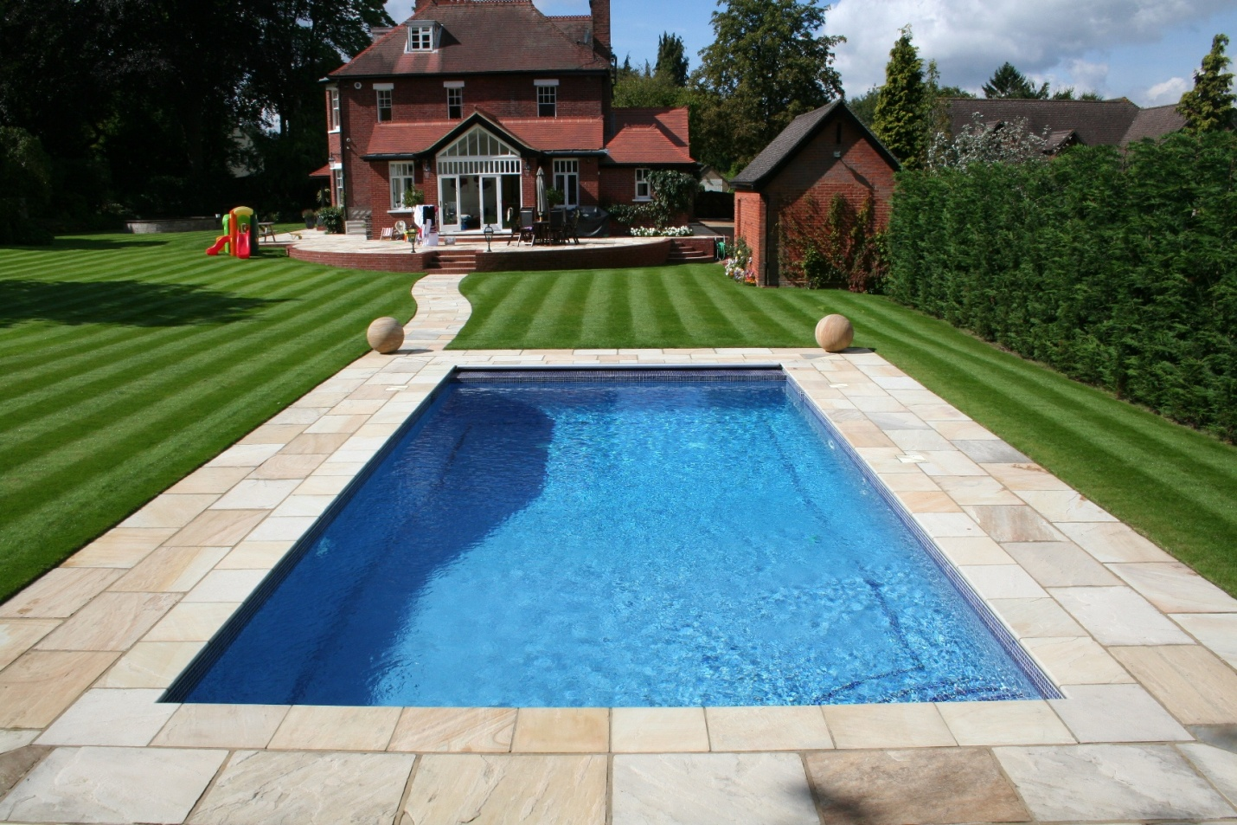
WATER SAFETY AT THE SWIMMING POOL

Slide 14
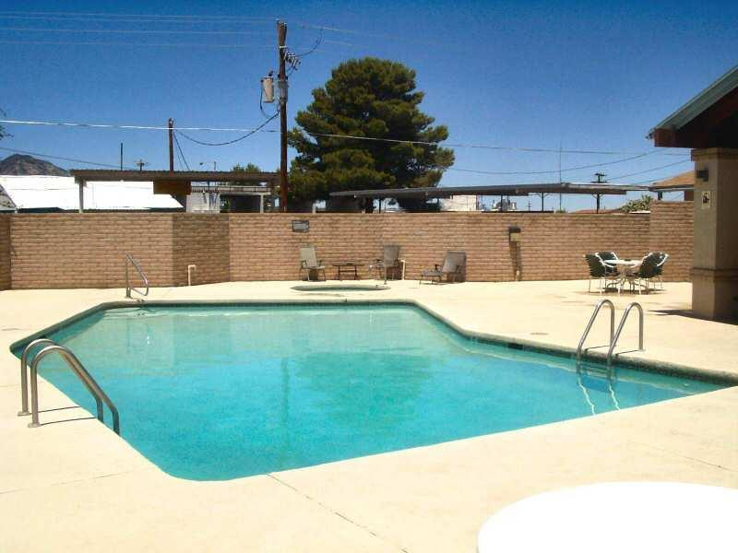
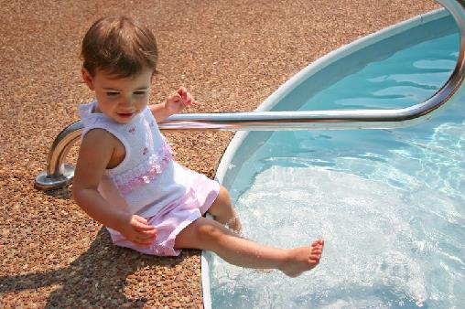
Water Safety at the Swimming Pool
Ensure all pool hygiene requirements are met
Read and adhere to all pool rules
The depth of the pool should be clearly marked at both ends

Slide 15
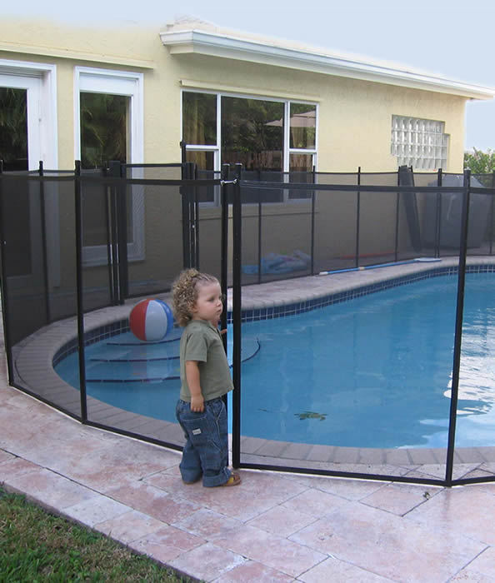
Water Safety at the Swimming Pool
Precautions to be taken:
Supervise children in, on or near water.
Fence home pools and include self-closing gates.

Slide 16
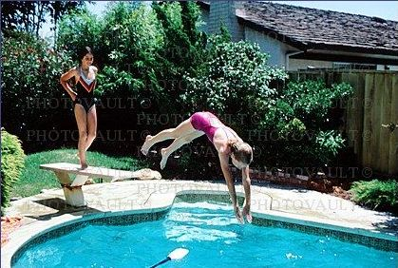
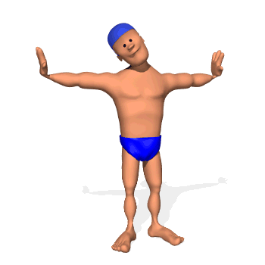
Danger of Diving into Swimming Pools
Note: In clear pools, the depths of the water may
deceive you. Incompetent divers may hit their head on
the pool bottom

Slide 17
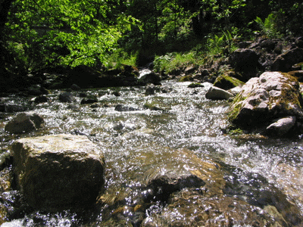
WATER SAFETY AT RIVERS

Slide 18
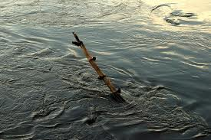
Water Safety at Rivers
Beware of submerged objects, such as; trees, branches, rocks and discarded rubbish.

Slide 19
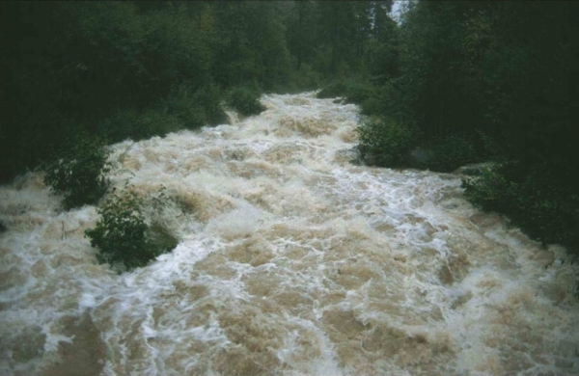
Water Safety at Rivers
STAY AWAY! Fast-flowing water is very dangerous.

Slide 20
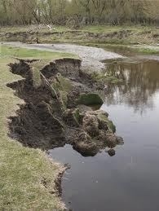
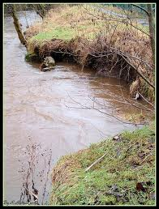
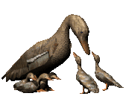
Water Safety at Rivers
STOP!
Crumbling river banks

Slide 21
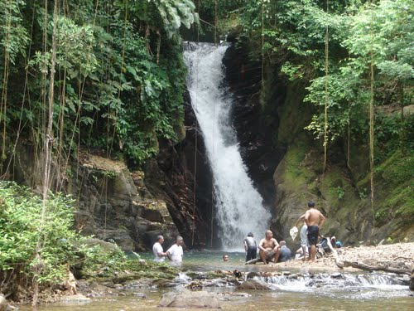
WATER SAFETY AT WATERFALLS
Diving from unknown waterfalls are dangerous

Slide 22
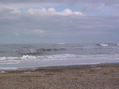
WATER SAFETY AT BEACHES

Slide 23
Every year thousand of holyday-makers have
great fun on the beaches; but it is not always
easy to stay safe. Some- times people are
unaware of the dangers and simply make bad
decisions which lead to them being swept out
to sea, falling off cliffs or rocks.

Slide 24
Role of the Lifeguard
A lifeguard is a professional emergency
responder, whose responsibility is to prevent
incidents and to rescue individuals using
special equipment in all aquatic environment.

Slide 25
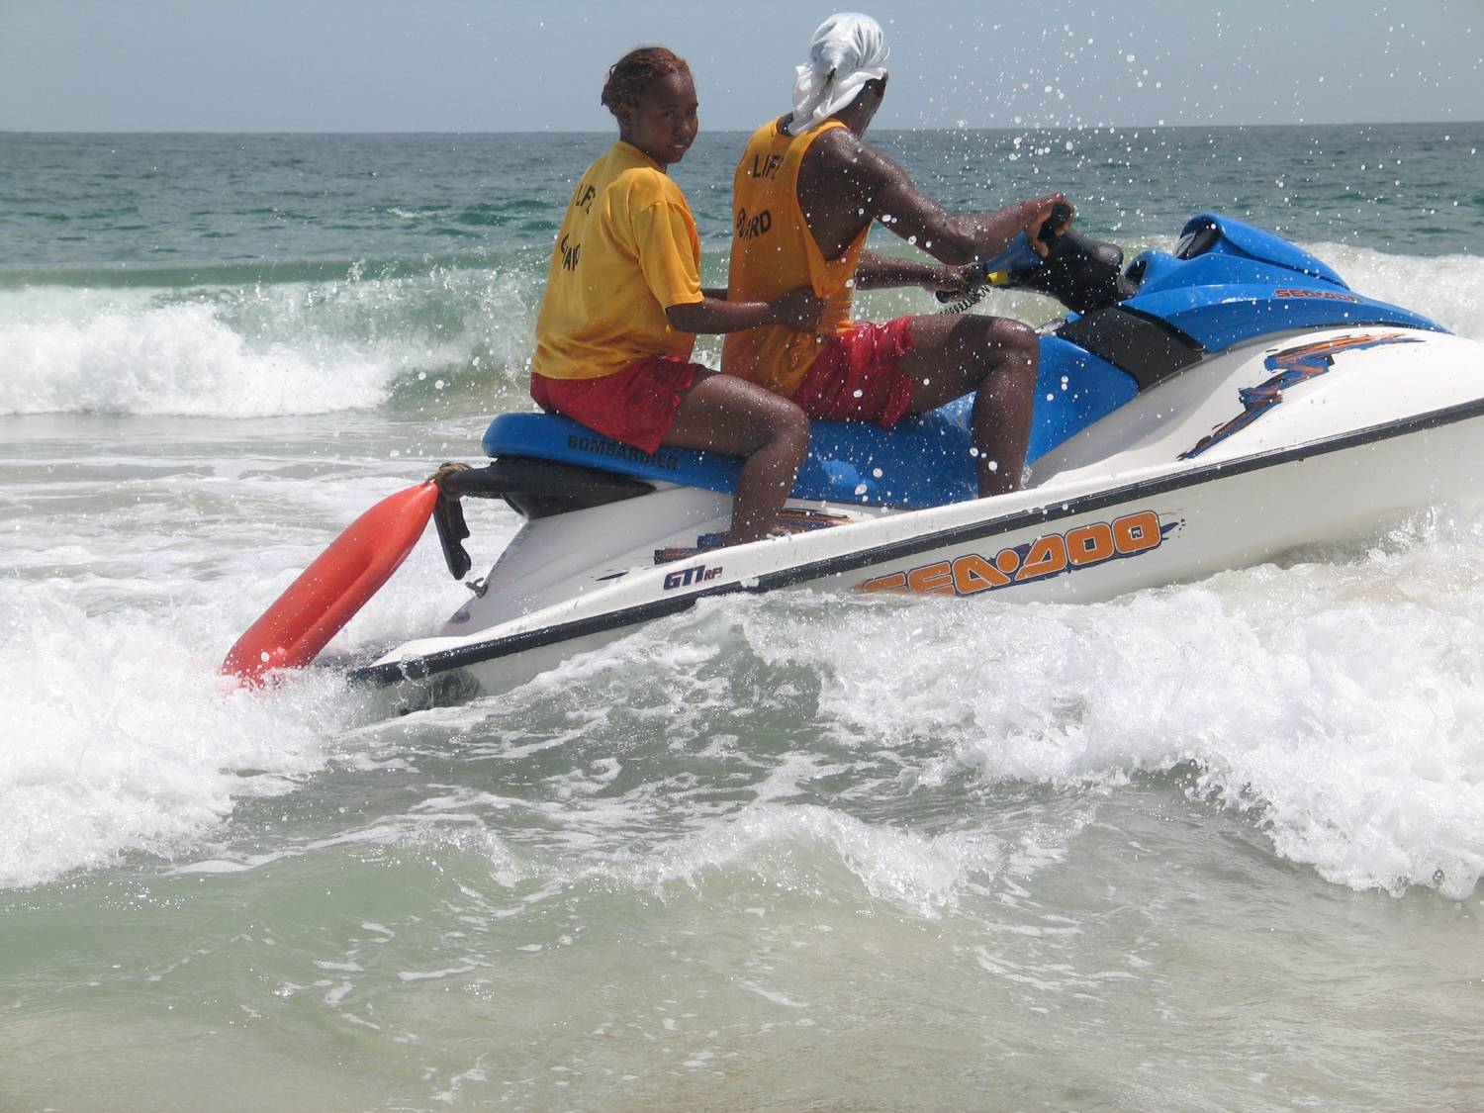
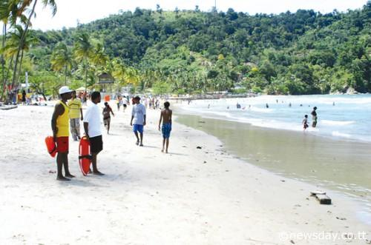
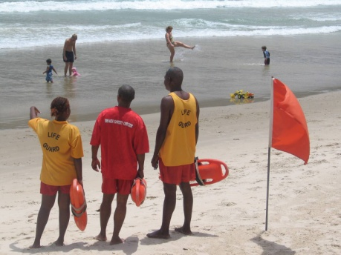
Hours of Lifeguard Patrol
10:00a.m – 5:30p.m

Slide 26
BEACHES PATROLLED BY LIFEGUARDS
MARACAS BAY
LAS CUEVAS
TYRICO BAY
MANZANILLA BAY
MAYARO BAY
SALYBIA
(SALINE BAY)
TOCO/SALYBIA
QUINAM BAY
LOS IROS BAY
VESSIGNY BAY

Slide 27
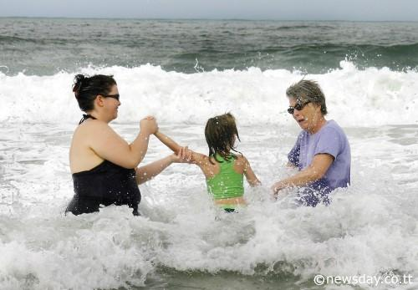
At the seaside, remember to always think SAFE

Slide 28
S – Spot the dangers
A – Always go with a friend
F – Find and read the safety signs and flags
E – Emergency! Stick your hand up and shout, tell a
lifeguard

Slide 29
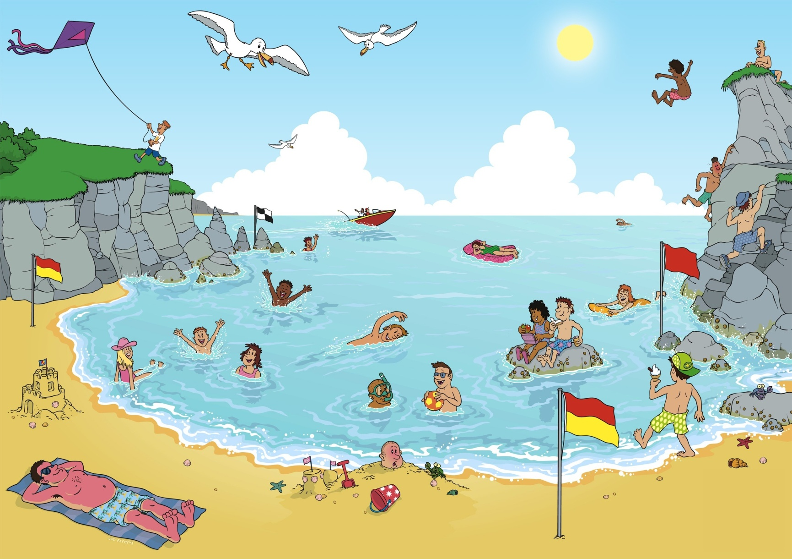
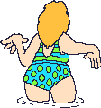
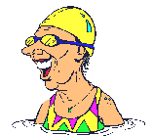
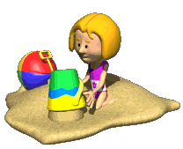
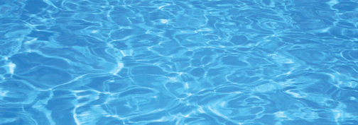
A Day at the Beach

Slide 30
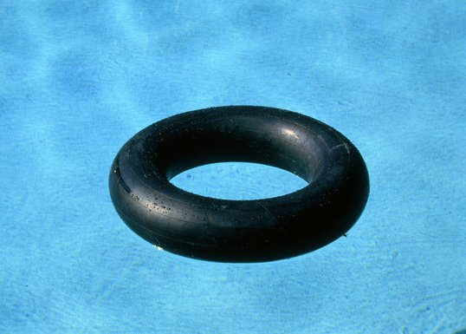
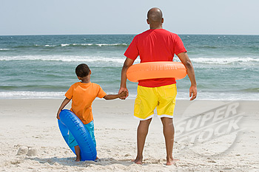
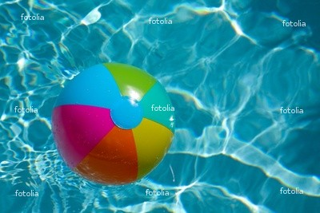
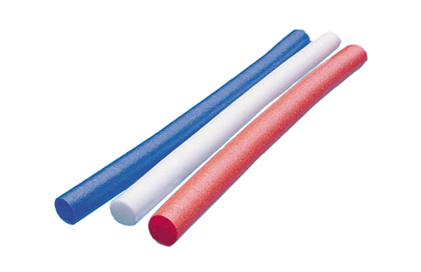
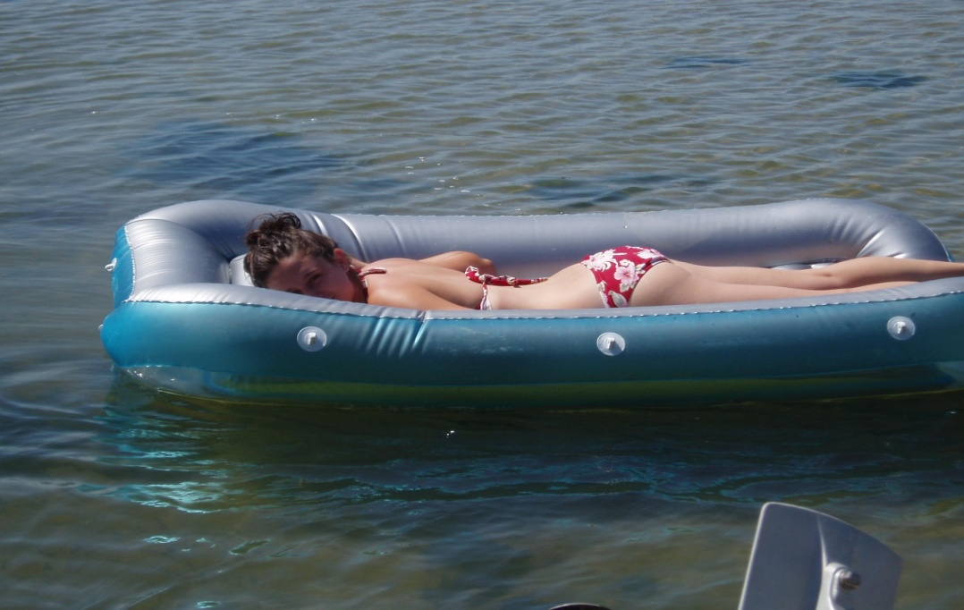
DANGERS OF FLOATATION DEVICES

Slide 31
Dangers of Floatation Devices
Non & weak swimmers should never depend on
floatation devices, with them they develop a false
sense of security.
Non & weak swimmers can easily lose their balance
and fall off
Non & weak swimmers attempting to retrieve a
floatation device may create waves of water between
themselves and float.

Slide 32
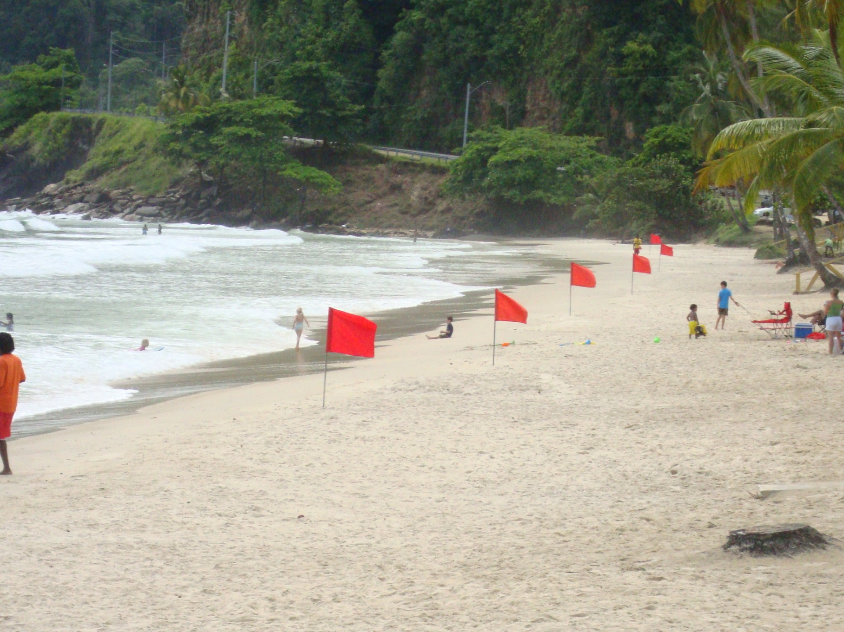
FLAGS
DO NOT bathe in front red flag

Slide 33
Note
Bathe between yellow and red flags
Do not bathe in front or near the red flag due to rip
currents

Slide 34
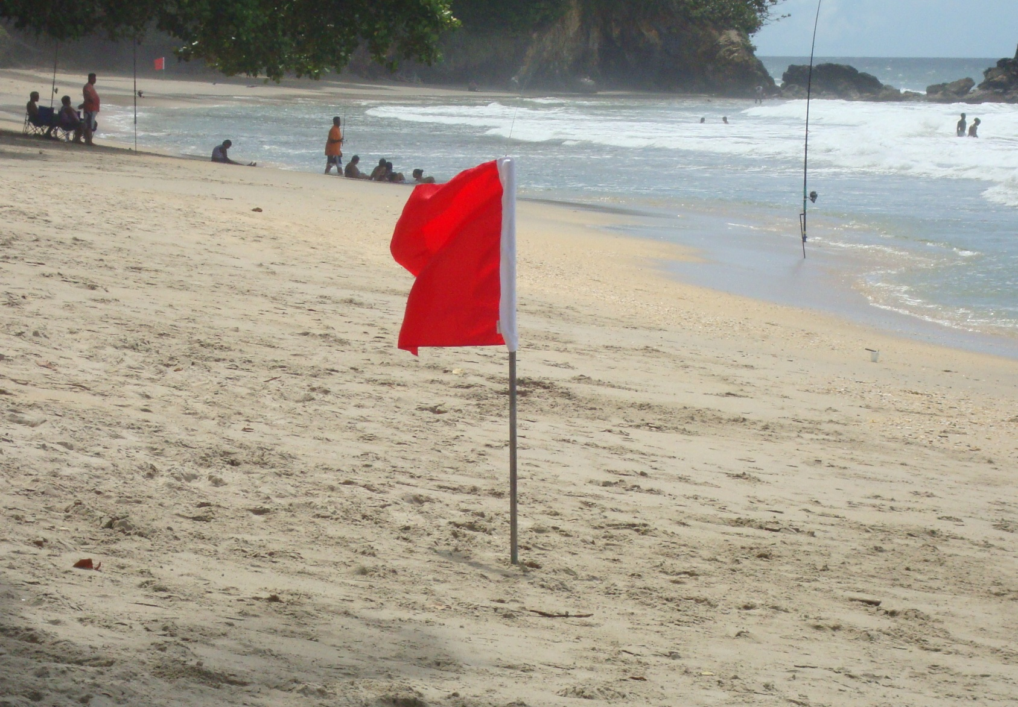
FISHING
FISHING BETWEEN BATHERS IS DANGEROUS

Slide 35
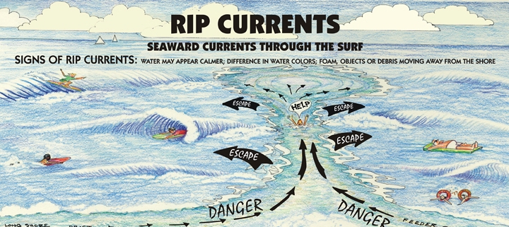

Slide 36
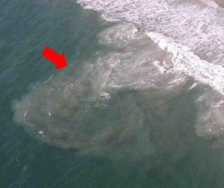
Rip Current (Early Stage)

Slide 37
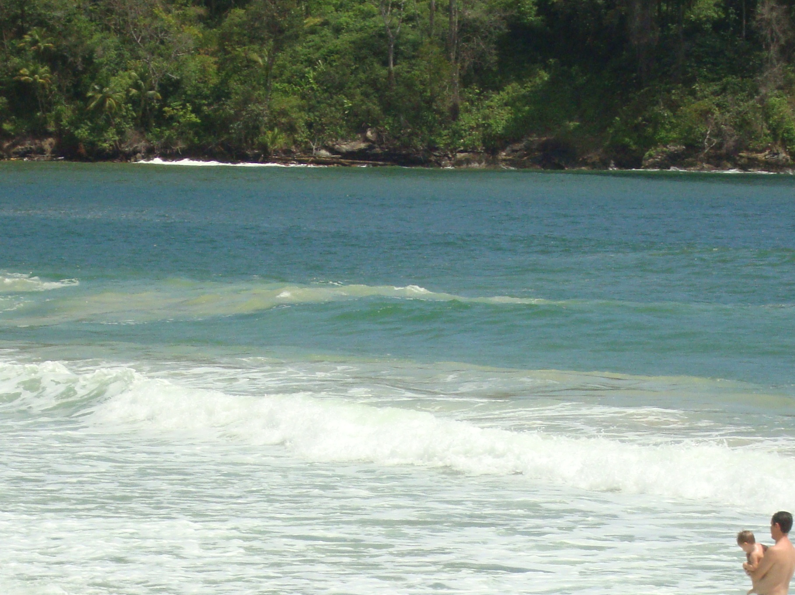
Rip Current (Early Stage)
DO NOT swim against Rip Current

Slide 38
RIP CURRENT (Fully Formed)

Slide 39
MISSING CHILD
Keep your children in sight at all times.
Tell them where to meet you if they get lost e.g.
lifeguard station.
If you do become separated, DO NOT panic. Look
around you and where you last saw them.
If you CANNOT find them, tell a lifeguard

Slide 40
Missing Child
If there is no lifeguard on duty, inform the police. Give
a description (age, what they are wearing) and the time
and place where you last saw them.
IF YOUR CHILD IS FOUND,
MAKE SURE TO TELL THE
LIFEGUARD OR POLICE

Slide 41
DANGERS OF MAN- O- WAR
The most dangerous species in our local waters is the
Portuguese Man O War, known for its painful, powerful
sting. The toxins secreted from its tentacles are about
75% as powerful as cobra venom.

Slide 42
TREATMENT
Leave the water immediately
Pick off any visible tentacles with a gloved hand, stick,
or anything handy, being careful to avoid further injury
Rinse the sting thoroughly with salt or fresh water to
remove any adhering tentacles
Apply ice for pain control

Slide 43
TREATMENT
Seek Medical Attention:
If pain is not relieved by ice packs
If encountering breathing difficulties
Any other symptoms

Slide 44
MARINE CREATURE “Sand Dollar”
DO NOT REMOVE FROM THE WATER TO PILE ON SHORE

Slide 45
WATER SAFETY TIPS

Slide 46
Alcohol and Water DO NOT Mix
Water Safety Tips
Do not go into the water when under the
influence of alcohol

Slide 47
Water Safety Tips
After eating wait at least one (1) hour before going into
water

Slide 48
Water Safety Tips
Consult with the lifeguard before entering the water
If there is no lifeguard around enquire from residents
about water conditions
Observed water conditions for a few minutes before
entering the water
Look for rip currents
when in the water bathe where there is firm sea bed
and no shifting sand under feet

Slide 49
Water Safety Tips
Avoid swimming areas where there are:
pot holes;
shifting sand;
and brownish discoloration of the water.
Brownish water beyond breaker

Slide 50
Water Safety Tips
Supervise children at all times around water
Non and weak swimmers should not venture into water
than their waist
Alcohol and swimming never mix
Take a fixed marker, e.g. a tree, on shore and make
regular checks to ensure you do not drift

Slide 51
Water Safety Tips
DO NOT travel in overload vessel
ALWAYS wear life jacket

Slide 52
Water Safety Tips
Whether at the river or at the beach, get out of the
water during lightening, strong winds and avoid
turbulent waters

Slide 53
DO’s
Learn to swim
Watch small children closely
Look for, read, and obey ALL beach safety flags and
signs
Ask a lifeguard about ocean water safety conditions
If you are in trouble, call or wave for help

Slide 54
DON’Ts
Don’t dive into unknown waters
NEVER swim alone
Do not push others under water
Do not float where you cannot swim
Non or weak swimmers should not use inflated devices
in the water
NEVER FAKE ACTIONS OR CALLS FOR HELP

Slide 55
IMPORTANCE OF LEARNING TO SWIM
It is enjoyable and recreational
It has health benefits and it is a complete form of
exercise
Being able to swim may save a life “your”

Slide 56
WATER SAFETY PREPARES US TO BE SAFE IN AND AROUND WATER
THANK YOU

