Slide 1


An HSE Initiative of
COTEEL
in collaboration with
Nestlé Trinidad and Tobago Limited
Presents
April 3rd 2014

Slide 2
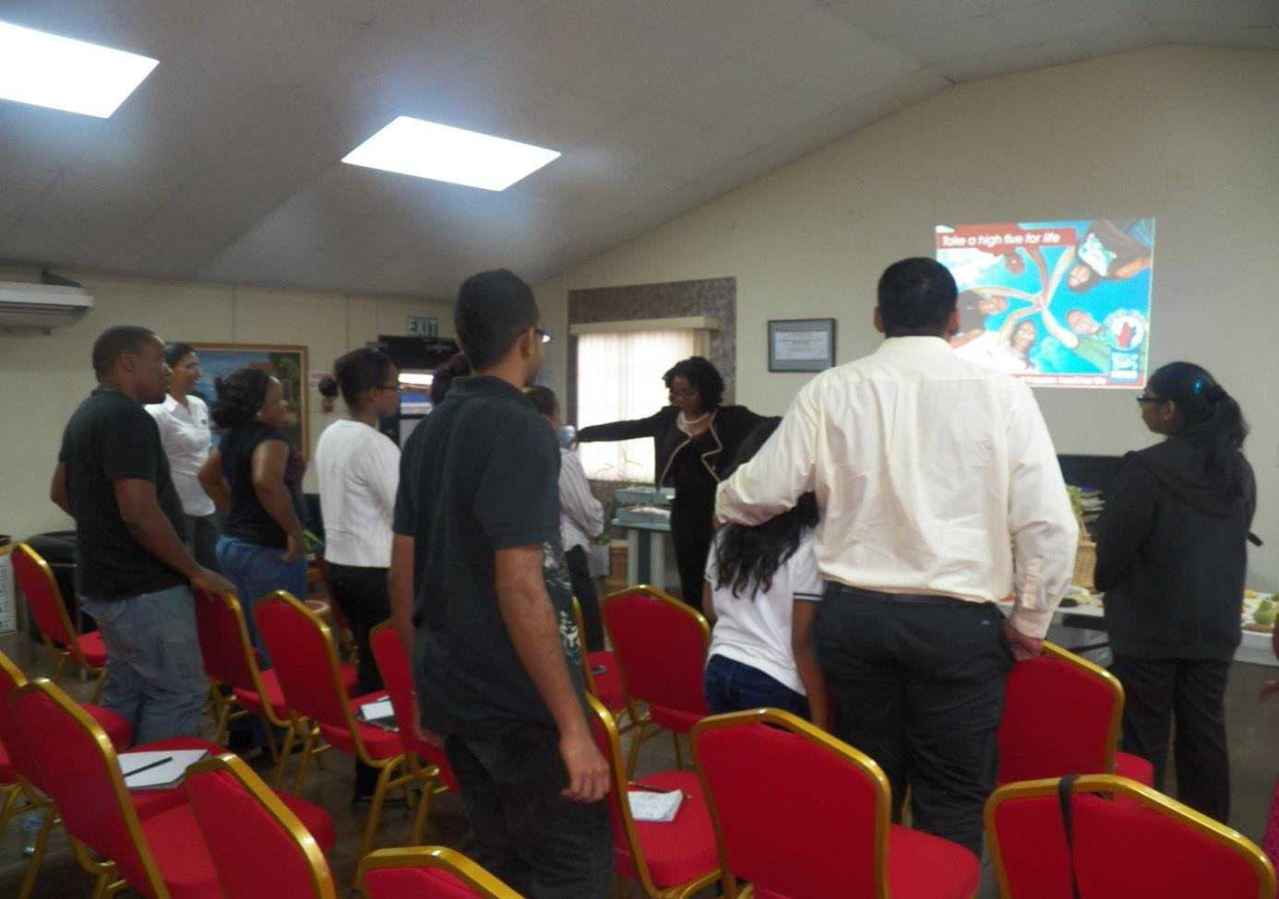
Thursday 3rd April 2014
Nestlé Nutritionist, Ms. Shaunelle Mieres
with COTEEL Staff and Invited Guests on an
Healthy Living Session- Take a High Five for Life

Slide 3

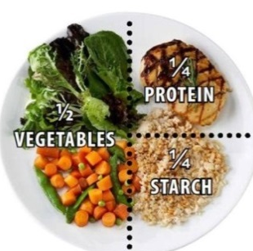


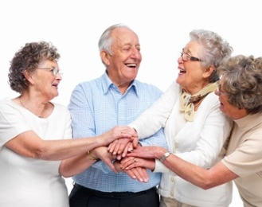
Everyone can live that Healthy Lifestyle by following these (5) Five steps:
1. Eat Healthy
2. Control Portions
3. Be Active
4. Check Health
5. Be Happy

Slide 4



The Six (6) Food Groups
Persons should have at least 6-11 servings from this group everyday depending on their age and level of activity.
This group provides vitamins and minerals. Include at least 2-4 servings from this group daily.
This group provides vitamins and minerals as well as fibre. Include at least 3-5 servings from this group daily.

Slide 5


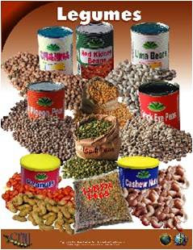
The Six (6) Food Groups
These foods contain cholesterol but also contains good sources of protein, calcium, zinc.
This group contains a large amount of calories(energy). Small amounts of these are needed daily to provide soluble vitamins.
Persons should try to have at least 2 servings from this group daily. This group is important for vegetarians and non-meat eaters.

Slide 6
Good to Remember
Good to Know
a) Drink at least eight (8) glasses or water daily.
a) A healthy Body Mass Index:
is between 18.5-24
b) Choosing fruit as mid-morning and afternoon snacks is a great way to get beneficial nutrients.
b) A normal Blood Pressure:
is 110-120/80
c) Daily Fibre Servings:
Women: 25g
Men : 30g
c) Include vegetables in every meal, start with some lettuce, tomatoes and cucumbers in your sandwich.
d) Body Fat Percentage:
Women :25-31%
Men: 18-25%
d) Exercising can improve your flexibility, control body weight and reduce stress levels.
e) A healthy Blood Sugar level:
is 80-120mg/dl
e) Getting adequate rest is essential to recharge your blood cells and revitalise yourself to face it all again tomorrow.
f) Cholesterol Level should be around 200mg/dl

Slide 7
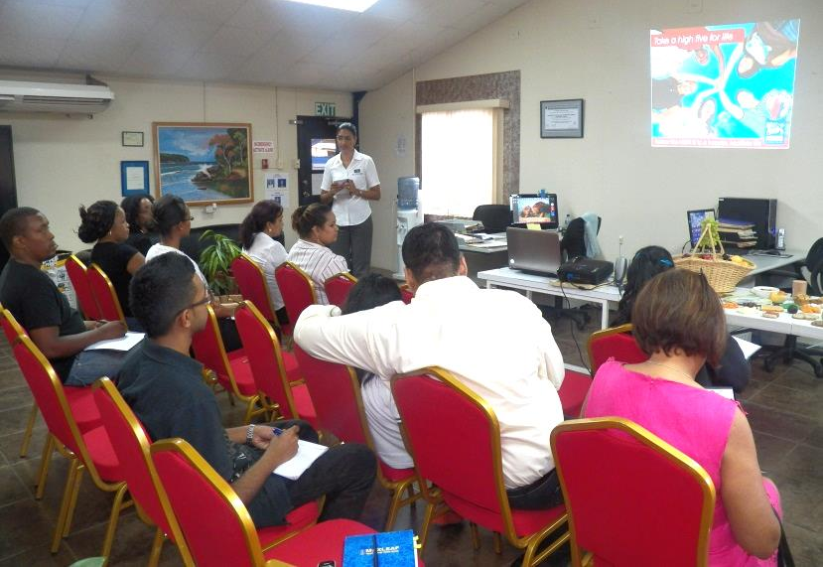
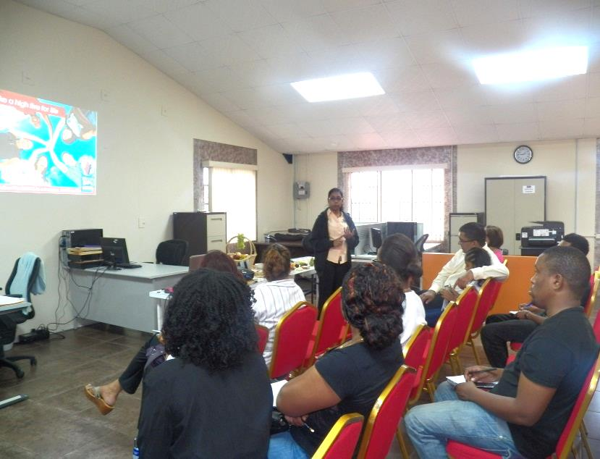
Photos: Healthy Living Session- Take a High Five For life
COTEEL HSE Representative
Mrs. Tricia Moonan welcomes
Guest Speaker Ms. Shaunelle Mieres,
Nutritionist from Nestlé.
COTEEL Fire/Floor Warden Ms. Amanda Sukha informs the audience about COTEEL’s Emergency Evacuation Procedures

Slide 8
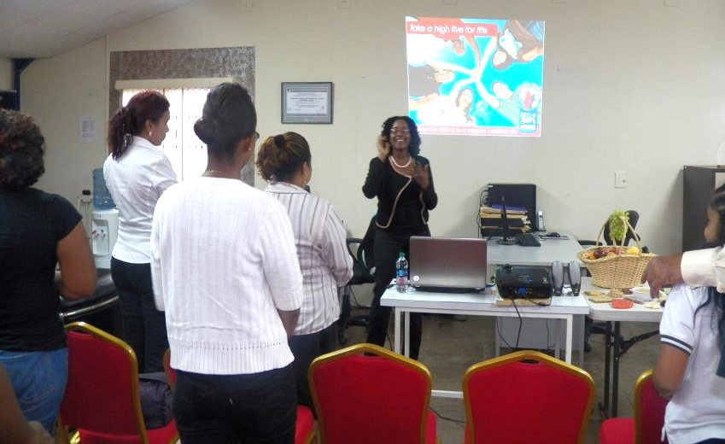
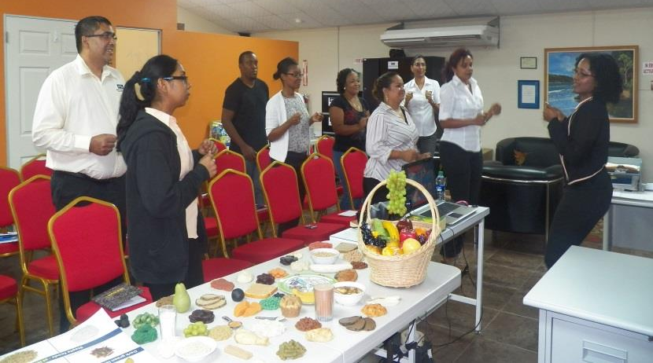
Photos: Healthy Living Session- Take a High Five For life
Ms. Shaunelle Mieres invites
her audience to participate
in an activity.
Audience participates enthusiastically.

Slide 9
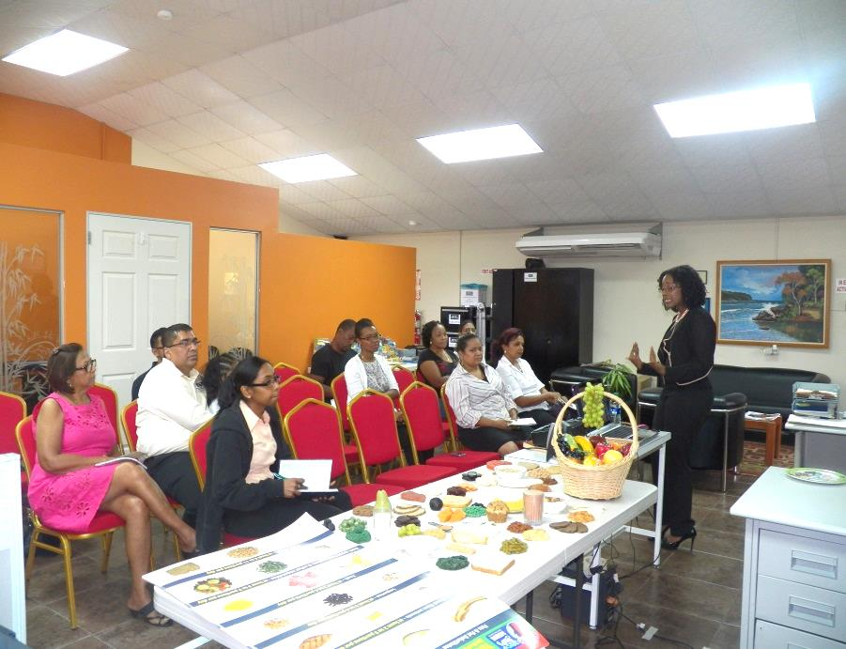
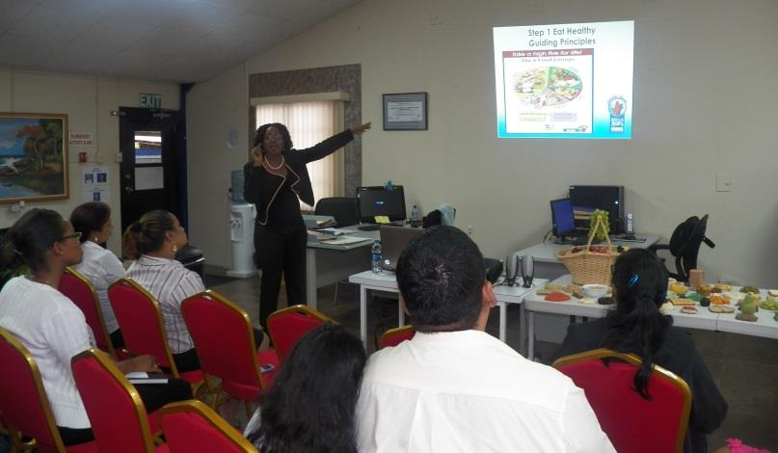
Photos: Healthy Living Session- Take a High Five For life
Mrs. Mieres and her audience
in an Interactive Session.
Mrs. Mieres displays Guiding Principles in Eating Healthy.

Slide 10
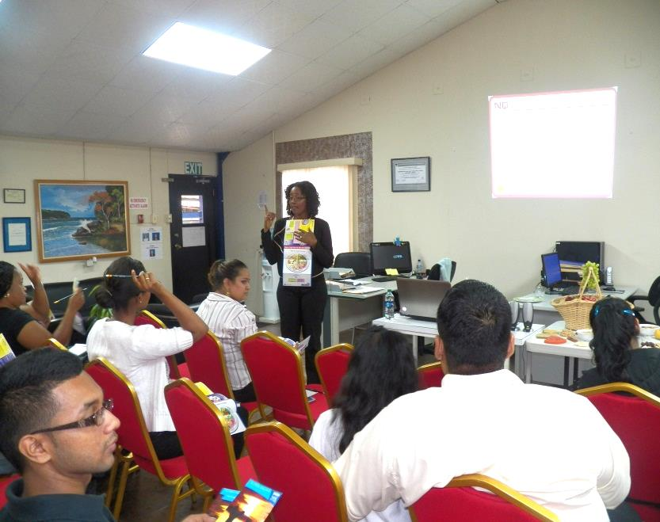
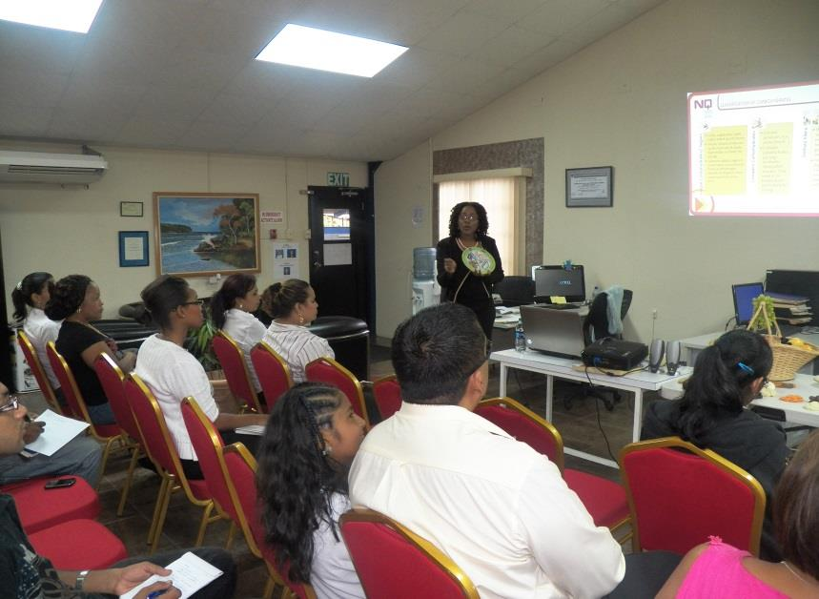
Photos: Healthy Living Session- Take a High Five For life
Mrs. Mieres introduces the Six Food Groups. Members were allowed to ask questions and share their views.
Portion Control- The recommended amount of servings from each food group.

Slide 11
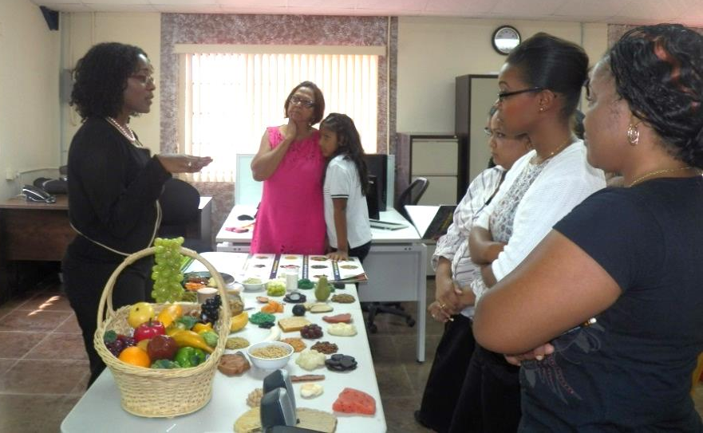
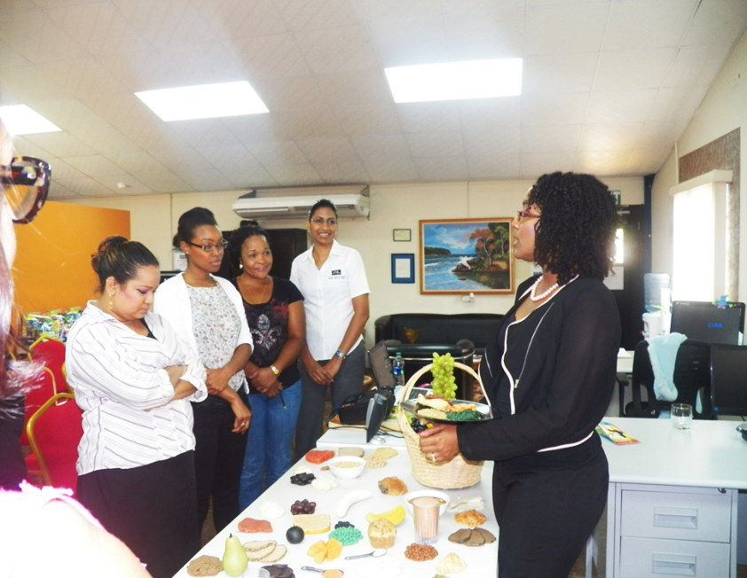
Photos: Healthy Living Session- Take a High Five For life
Audience gather at display table to learn more about portion control.
Mrs. Mieres explains different ways of mixing and matching food as COTEEL staff and guests looks on.

Slide 12
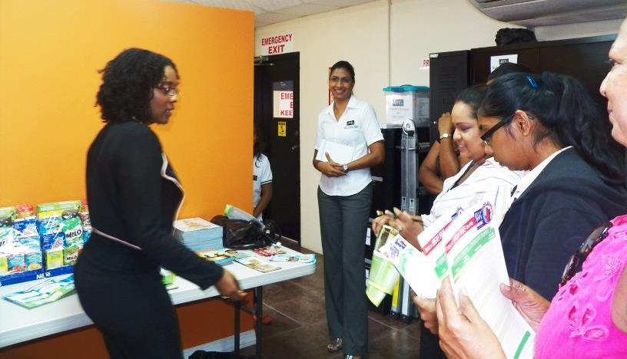
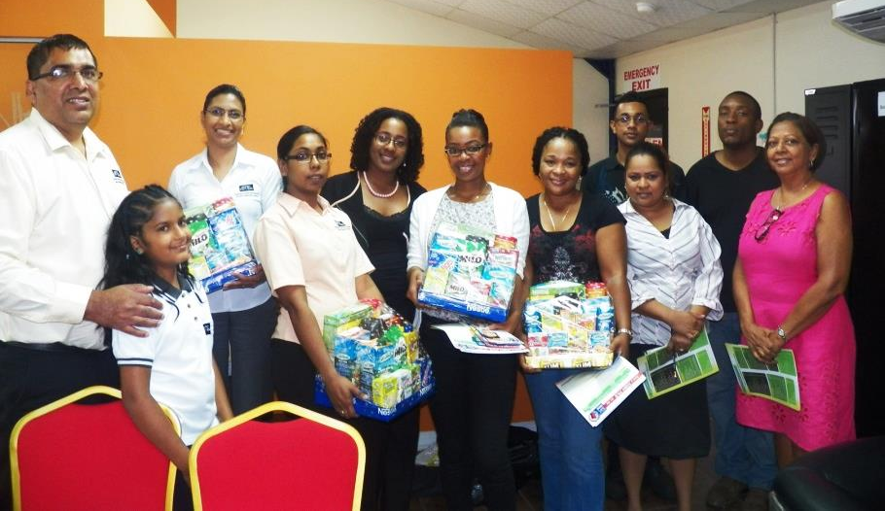
Photos: Healthy Living Session- Take a High Five For life
Audience receives brochures and charts on Healthy Living.
COTEEL Staff and Invited Guests with Hampers presented by Mrs. Shaunelle Mieres from Nestlé.

Slide 13
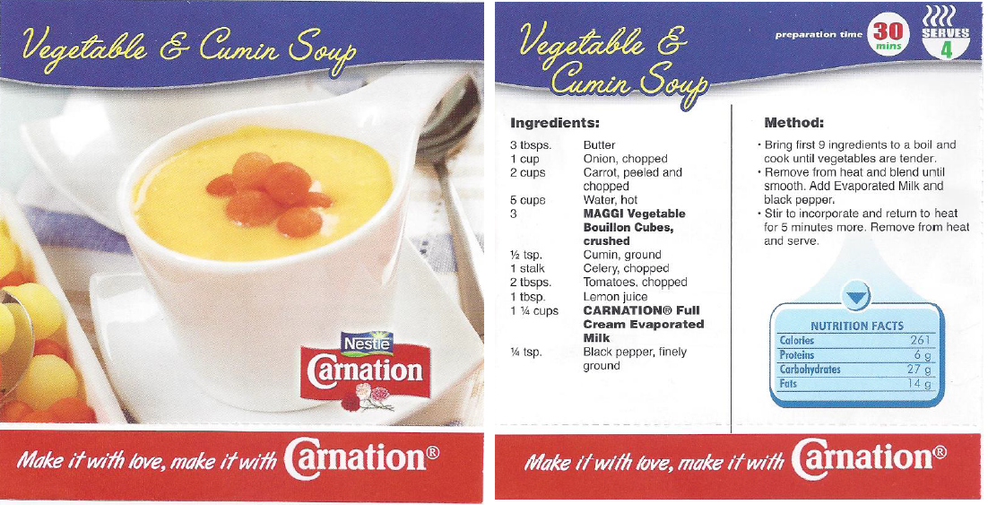
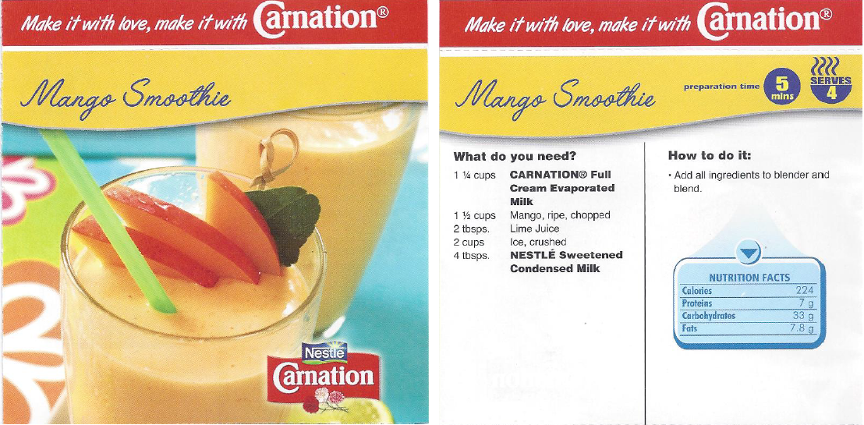
Recipes Courtesy Nestlé -Take a High Five for Life

Slide 14
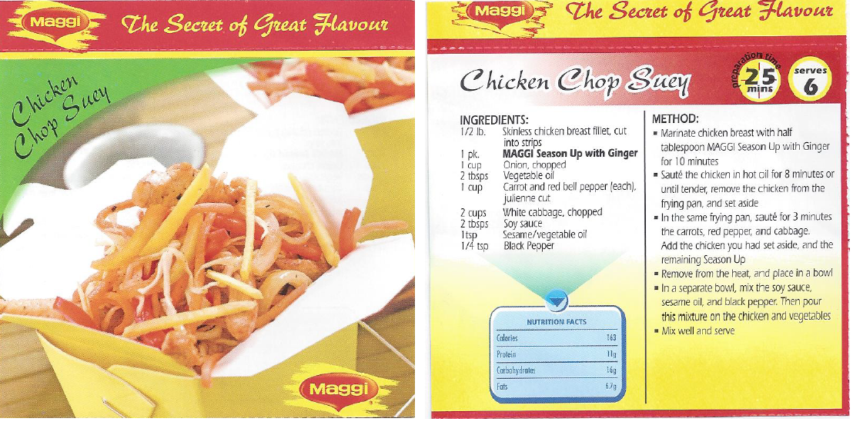
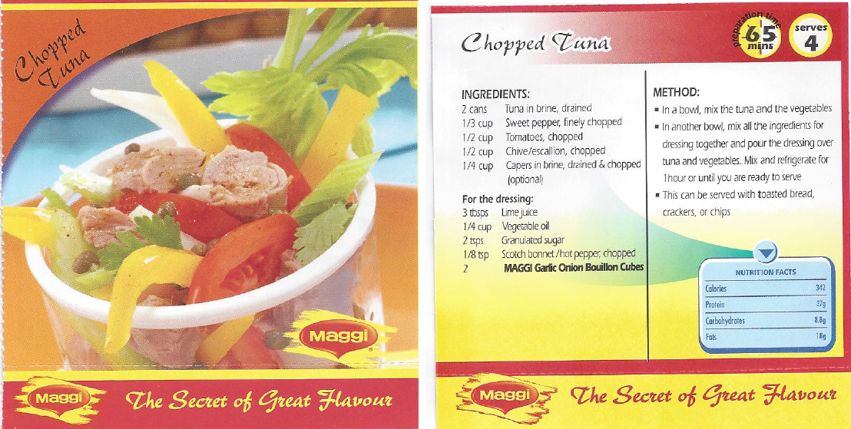
Recipes Courtesy Nestlé -Take a High Five for Life

Slide 15
For more information on Healthy Living visit
www.nestle.com or www.highfiveforlife.com

